Slide 1


Machine Learning / Predictive Analytics (Classification)
QMSS 301 - Quantitative Social Science Analysis and Big Data

Slide 2

AI & ML: Artificial Intelligence & Machine Learning
Artificial Intelligence
Machine Learning
AI is trained final output machine which mimic like human brain
Ex: Amazon Alexa
ML is a subset of AI. It is a technique to achieve AI. Ex: Spam Detection

Slide 3
Machine learning is a subset of artificial intelligence (AI) that focuses on the development of algorithms and models that enable computers to learn and make predictions or decisions without being explicitly programmed to do so.
In traditional programming, humans write explicit instructions to tell a computer how to perform a task. In contrast, in machine learning, computers learn from data and improve their performance on a specific task through experience.

Slide 4

Applications of AI & ML
1. Transportation and Navigation
With AI-enabled mapping, it scans road information and utilizes algorithms to identify the optimal route to take, be it in a bike, car, bus, train, or on foot.
Autonomous Vehicles: AI powers self-driving cars and drones.
Traffic Management: ML models analyze traffic patterns to optimize routes.
Ride-Sharing and Navigation: Apps use AI to find the best routes and share rides.

Slide 5

Applications of AI & ML
2. Social media
Facebook uses advanced machine learning to do everything from serving content to you and to recognize your face in photos to target users with advertising.
Instagram uses AI to identify visuals.
LinkedIn uses AI to offer job recommendations, suggest people you might like to connect with, and serving you specific posts in your feed.

Slide 6

Applications of AI & ML
3. Healthcare
AI algorithms can analyze medical images (e.g., X-rays, MRIs) to detect diseases and abnormalities.
In addition, AI/ML models can predict patient risk factors and help in early intervention.

Slide 7
Applications of AI & ML
4. Finance
Algorithmic Trading: ML algorithms analyze financial data to make trading decisions in real-time.
Credit Scoring: ML models assess credit risk by analyzing financial and personal data.
Fraud Detection: AI systems detect fraudulent transactions by analyzing patterns and anomalies.

Slide 8
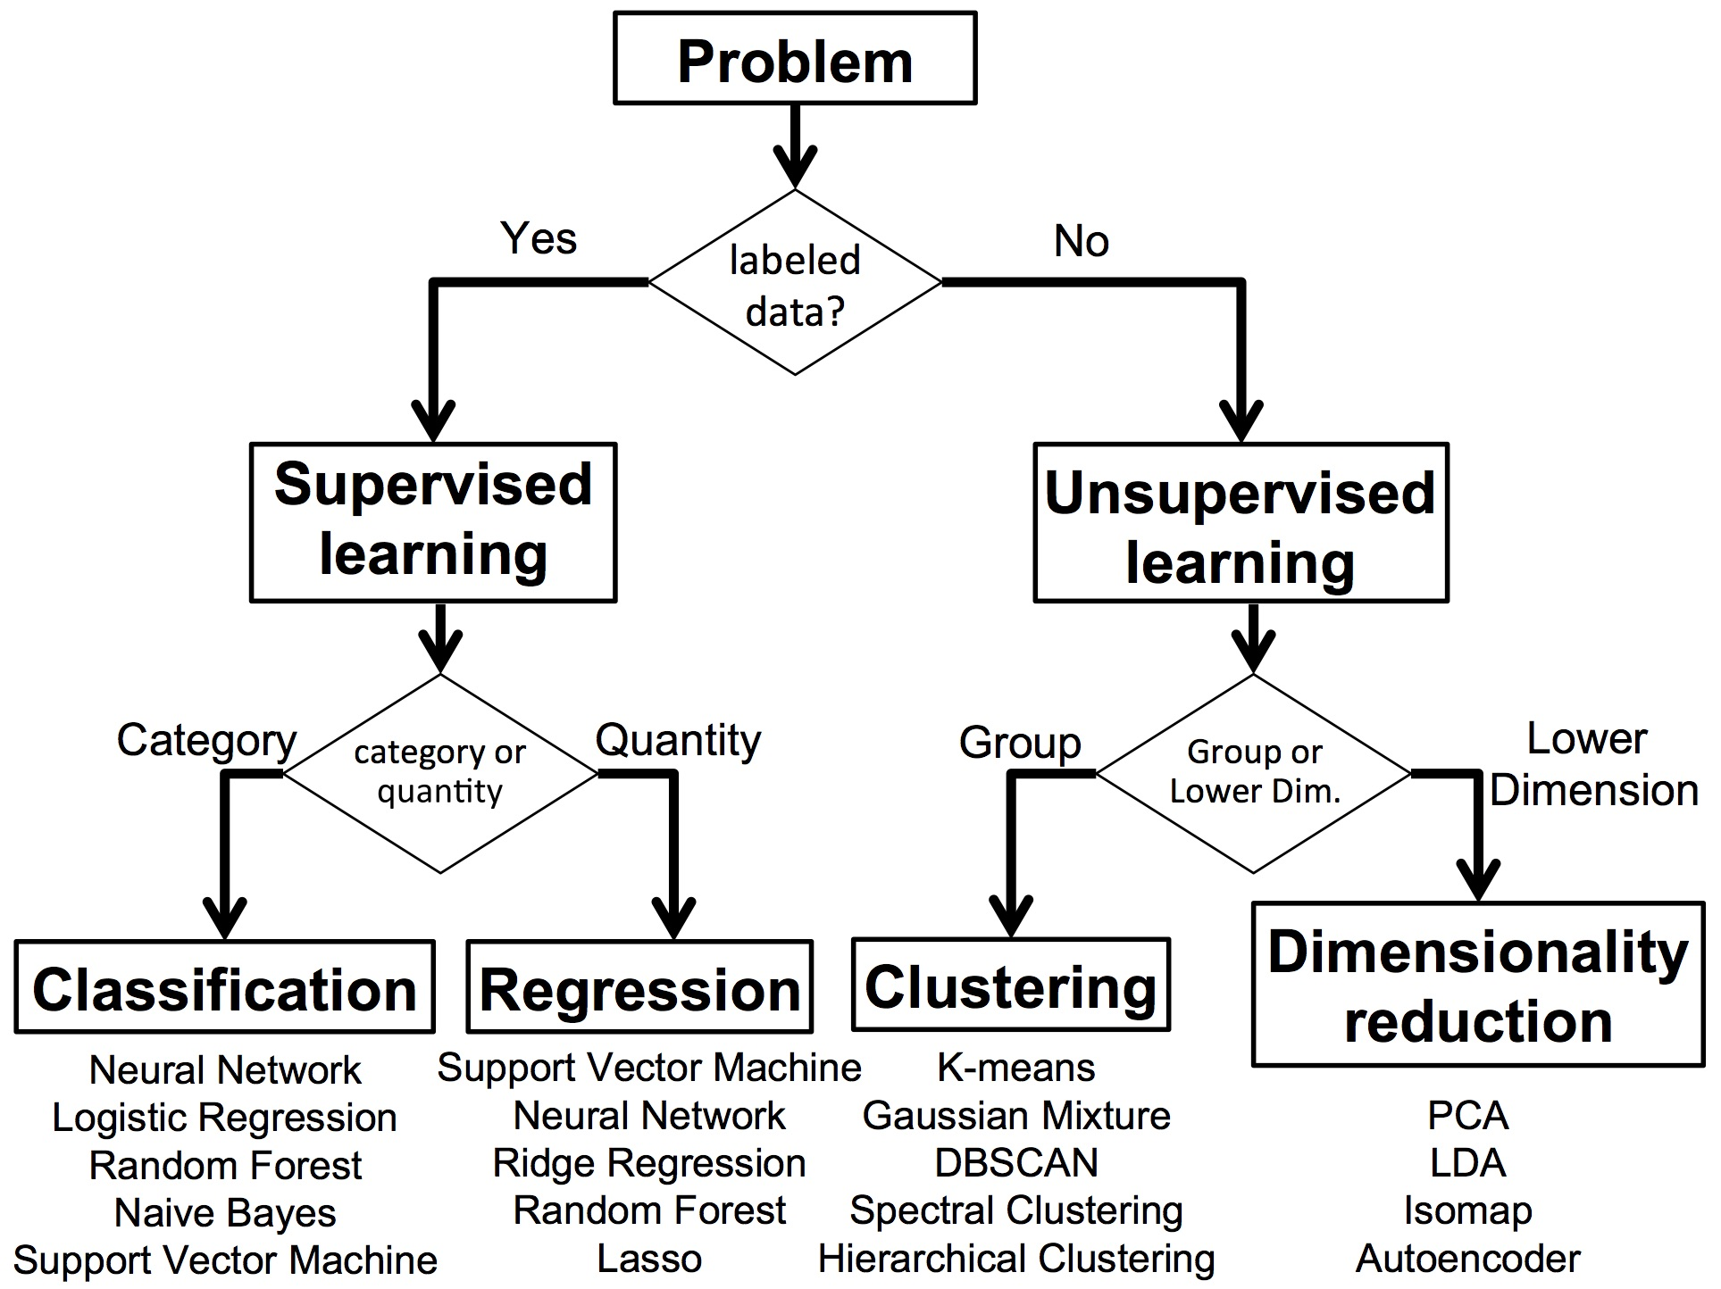
Types of Machine Learning Algorithms

Slide 9
Why Predictive Analytics?
Predictive analytics (PA) is also known as a “supervised learning” in statistics
Part of a large field of approaches in data mining – learning from “big” data
PA is used to predict the value of an outcome based on the number of inputs.
Assessing the classification/predictive accuracy of models is key.
Generally, types of model validation are used to assess accuracy.

Slide 10
Examples of Predictive Analytics
Some examples of PA problems:
  How can I predict whether a patient, hospitalized due to a heart attack, will have a second heart attack using data based on demographic, diet and clinical measurements for that patient?
  How can I predict the price of a single company’s stock in in a year from now, using data about company performance and general economic data?
  How can I predict who will be signaled into the child welfare system using data on their socio-demographics, past history of child welfare involvement, and other risk factors?
  Who will this voter choose, based on political preference and voting data for a population?
  How can I predict if a bank customer will default iin their loan repayment or not.

Slide 11
Predictive Analytics Project
Large, complex, unstructured data sets (i. e. “big data”) must be effectively cleaned, transformed, and preprocessed before they can be used.
Visualization plays a key role in understanding data.
In the project:
  You’re expected to build a multivariate model, using multiple predictors, to predict a binary response variable
  Understanding and visualizing your data are key tasks
  You’re expected to assess the classification accuracy of this model

